Slide 1

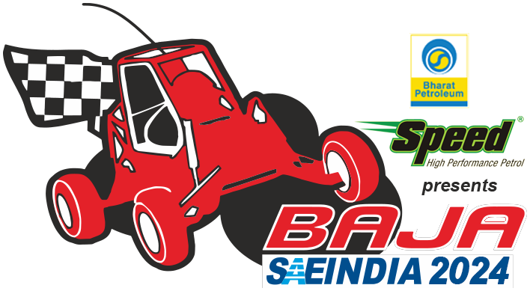


TRAILBLAZERS
INDIAN INSTITUTE OF ENGINEERING SCIENCE AND TECHNOLOGY, SHIBPUR
TEAM ID - 24102

Slide 2
Estimated Vehicle Cost, Weight & Specs.
Category | Items | Cost (₹)
Frame | Steel tubes, Sheet metal, Welding Supplies, Rollcage Padding, etc. | 35,000
Wheels and Tyres | Rims and Tyres | 48,000
Suspension | Shocks, Springs, Uprights,Spindles, A-Arms | 30,000
Steering | Rack & Pinion, Steering Column, Steering Wheel, Tie rods, etc. | 19,000
Braking | Calipers, Master Cylinders, Disc, Brake lines, etc. | 15,000
Power Train |  | 60,000
Safety Equipments | Driver's Suit, Seat Belts, Seat, Fire Extinguishers, Kill Switch, etc. | 60,000
Miscellaneous | Fasteners, Brake oil, Gear oil, Electricals, etc. | 5,000
Total 2,72,000
Components | Weight (kg)
Roll Cage | 32
batteries | 19
Transmission(PMSM motor, Controller, FNR,Speed reduction gear-box, CV joint Shafts) | 30
Wheels | 34
Suspension Assembly(Shocker, wishbone) | 24
Steering Assembly(rack, column, steering wheel, tie rod, hub,uprights) | 16
Braking Assembly(disc, callipers, brake lines, master cylinders) | 10
Seat & Panels | 10
Miscellaneous(fasteners, safety equipments, etc.) | 5
Total 180
VEHICLE STATISTICS​ | MEASUREMENT/DIMENSIONS​
 | FRONT​ |  | REAR​
 | Length/Dia.​ | Width​ | Length/Dia.​ | Width​
Overall Vehicle​ | Length = 71.2” |  | Width = 63.4”
Track​ Width | 59.05” |  | 58.58”
Wheel Base​ | 61.02”
Ground Clearance​ | 12”​ |  | 12”
Wheel/Type​ | ​23” | ​10” | ​23” | ​10”
Maximum Speed​ | 43km/hr
Gradeability​ | 88.74 %​
Stopping Distance​ | 6.874 m ​
Kerb Weight​ | 180 kg​
Weight Distribution​ | ​40% |  | 60%​
Sprung Mass​ | 180 kg​
Unsprung Mass​ | ​80 kg

Slide 3
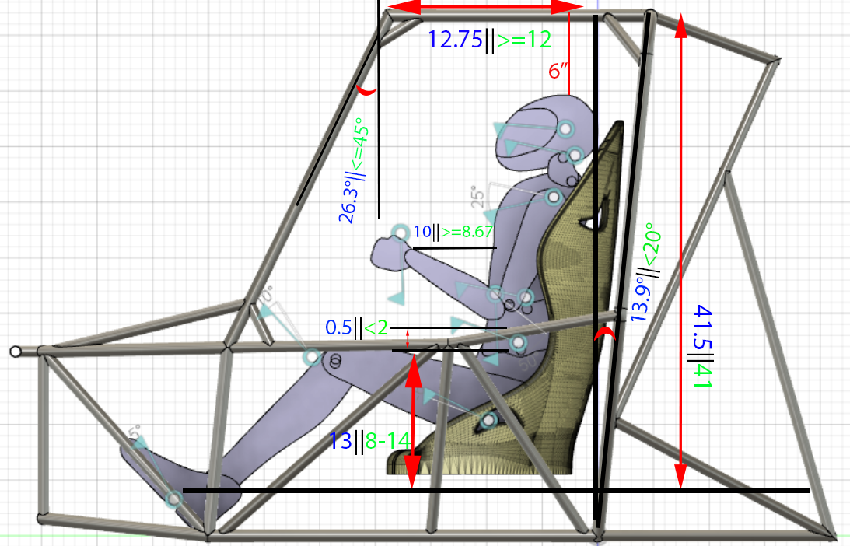
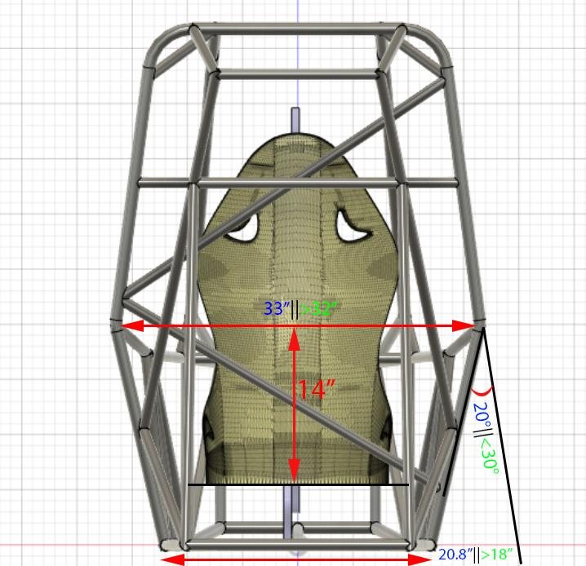
Priorities
BAJA Rulebook
Drivers comfort
Drivers Safety
Cost to Manufacture
Lightweight Rollcage
Design Process
CAD Design
Ergonomic Analysis
Upper Arm Score=+1
Lower Arm Score=+1
Wrist Score=+1
Neck Score=+1
Trunk Score=+1
Leg Score(REBA)=+2
Leg Score(RULA)=+1
Force/Load Score=1
Muscle Score=+1
Activity Score=+1
Coupling Score=0
ROLL CAGE DESIGN
CAE
Manufacturing Ability
​MEMBER | OUR SPECIFICATIONS |  | RULEBOOK SPECIFICATIONS
​ | Primary Members​ | Secondary Members​ | Primary Members​ | Secondary Members
Material​ | ​AISI 4130 | AISI 4130 | ​AISI 4130 | -
Size(mm)​ | ​29.21*1.65 | 25.4*1.2 | ​25*3 | >25.4*0.89
Bending Stiffness​ | ​2790.55Nm² | 1371.79Nm² | ​2619.416Nm² | 1056.3Nm²
Bending Strength​ | ​428.88Nm | 242.374Nm | ​373.10Nm | 150.12Nm
Final Result
 | RULA | REBA
Table A | 1 | 2
Table B | 1 | 1
Table C | 2 | 2
Final Score | 2 | 3

Slide 4
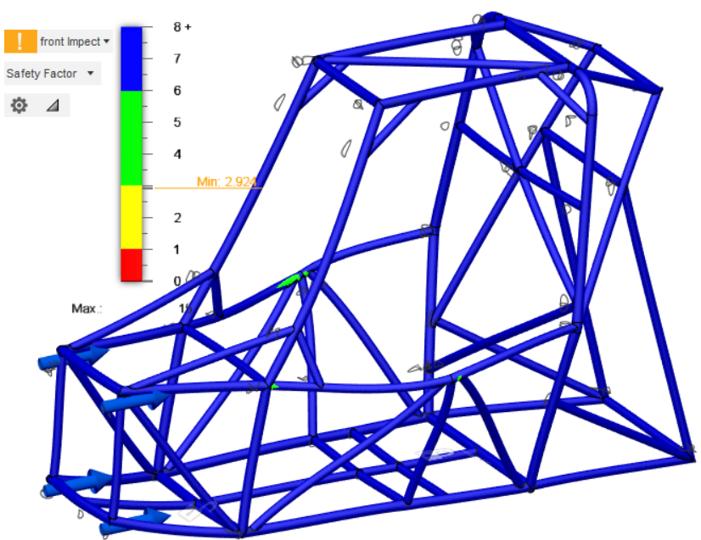
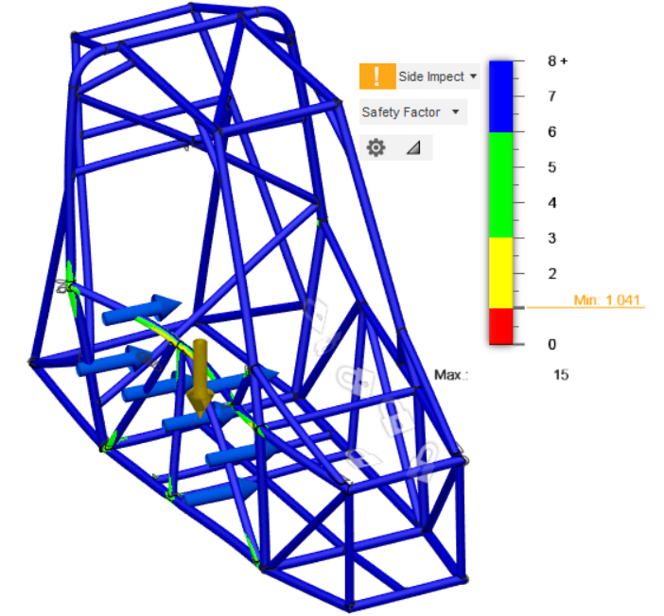
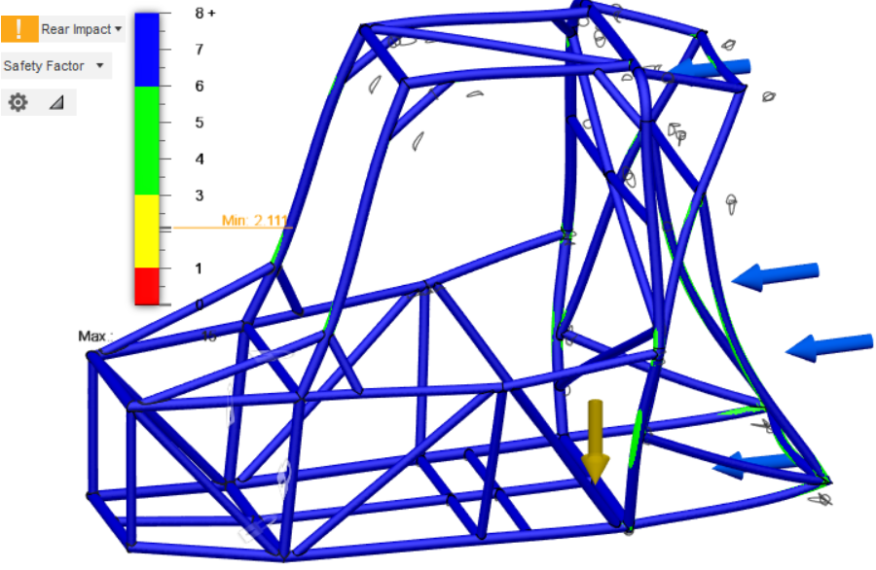
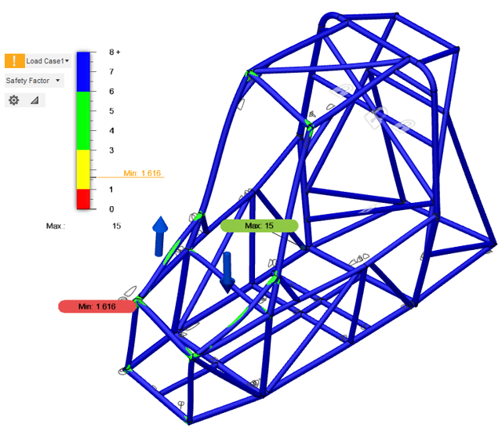
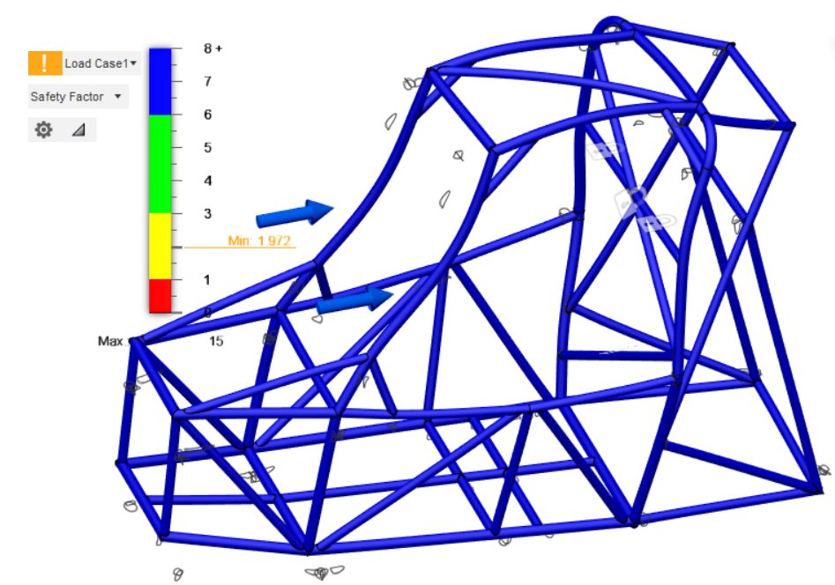
*Pictures shown here on Structural Simulation are Deformation pictures and the deformation is scaled for visualization.
MATERIAL PROPERTIES
Carbon Content​ | 0.3
Yield Strength​ | 460 MPa​
Ultimate Strength​ | 560 Mpa​
Percentage Elongation​ | ​21.50
Modulus of Elasticity​ | 205​
INDEX
Force Load
Front Impact
 | Load case | F.O.S ​ | Von mises ​ Stress(MPa) | Displacement (Max) ​(mm)
Front Impact ​ | 10G | 1.52 | 305.6 | 3.65
Side Impact ​ | 4.5 G | 1.091 | 422.4 | 8.616
Rollover ​ | 3 G | 1.752​ | 262.6​ | 3.177​
Torsion ​ | 2.5 G (M) | ​1.616 | ​284.4 | ​5.734
Rear Impact ​ | 4.5 G | ​1.811 | ​255.3 | ​7.125
CAE & APPLICATIONS
Side Impact
Rear Impact
​ | Mesh type​ | Element Size​ | Solver
Structural Simulation | Tetrahedral | ​7mm | Nastran
Torsion
Rollover

Slide 5
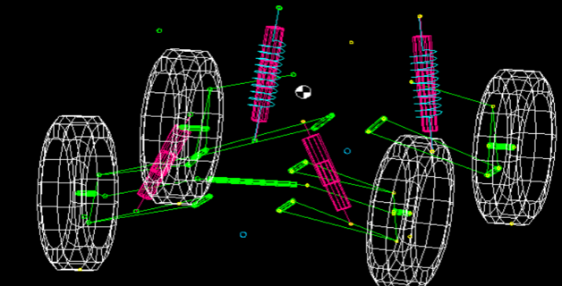
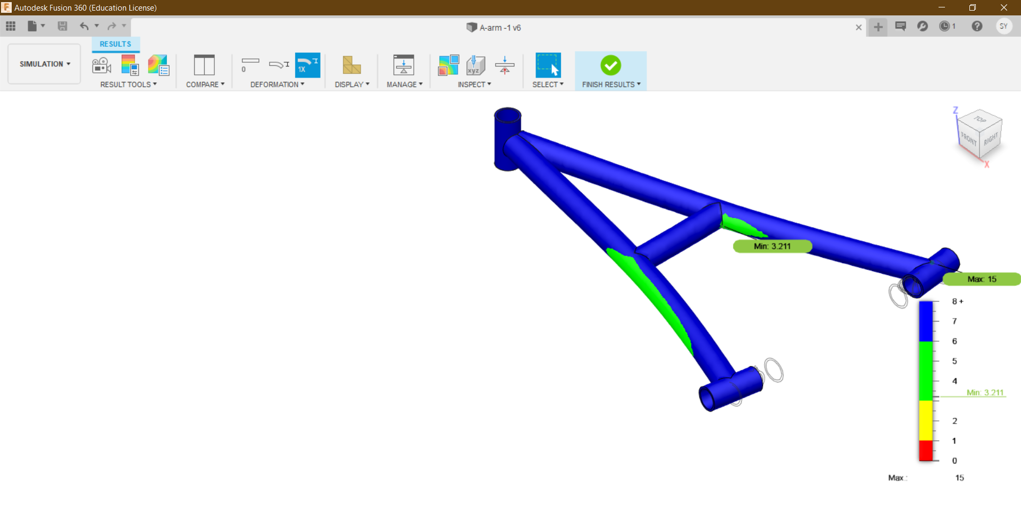
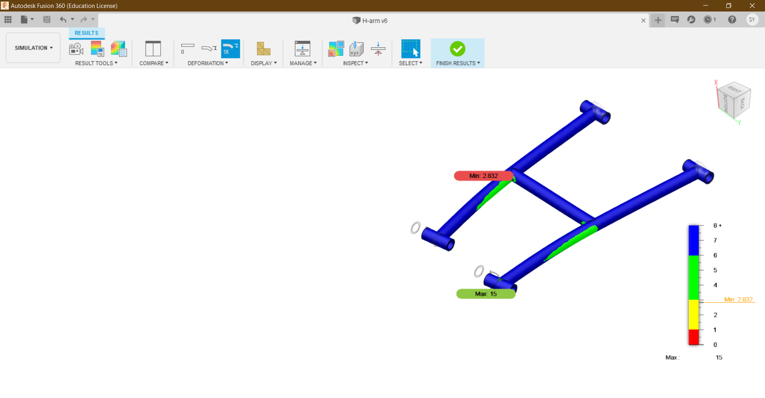
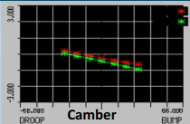
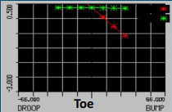
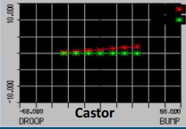
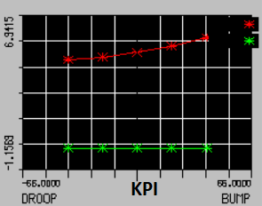
DECISION MATRIX
Types Sub | FRONT (1-10) |  |  | REAR (1-10)
 | Macpherson | Double-wishbone | Trailing arm | Semi-trailing | H-arm | Double-wishbone
Size & weight | 5 | 7 | 3 | 4 | 8 | 7
Wheel control | 3 | 8 | 8 | 7 | 8 | 9
Independent movement | 3 | 9 | 5 | 3 | 9 | 9
Stability | 3 | 8 | 8 | 6 | 9 | 8
Complexity | 6 | 8 | 4 | 5 | 9 | 8
Total | 20 | 40 | 28 | 25 | 43 | 39
PARAMETER | FRONT | REAR
Type | Double A Arm, Damper to Lower | H-arm with Single Upper Link
Roll Centre Height | 262.96 mm | 343.9 mm
CG Height | 24" | 24"
Camber/Toe/Castor | -0.25/0.35/0.72° | -0.45/0.35/0°
Kingpin Inclination | 5.11° | -
Scrub Radius | 0.537" | -
Motion Ratio | 0.62 | 0.58
Ride Frequency | 2.99 Hz | 2.69 Hz
Spring Rate | 4.884 N/mm | 5.189 N/mm
Wheel Rate | 12.705 N/mm | 15.426 N/mm
Ride Rate | 3.059 N/mm | 3.194 N/mm
Sprung Mass | 36 kg | 54 kg
SUSPENSION

Slide 6
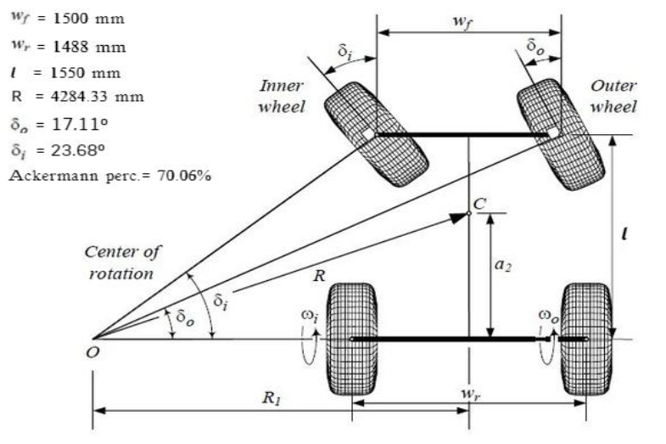
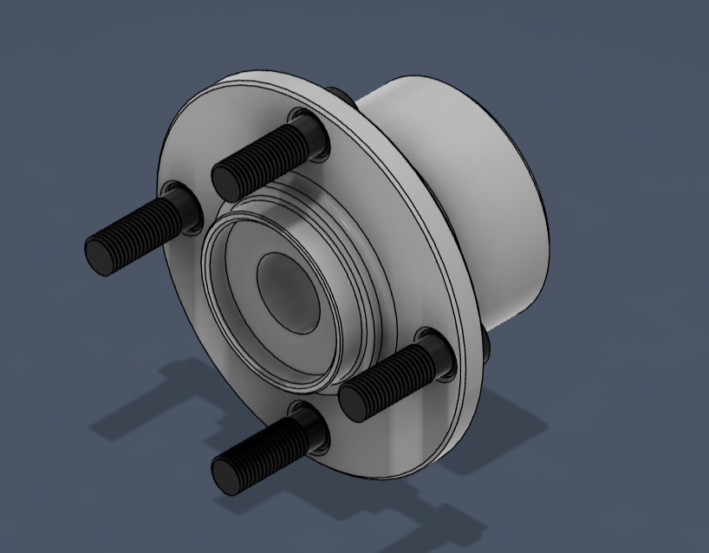
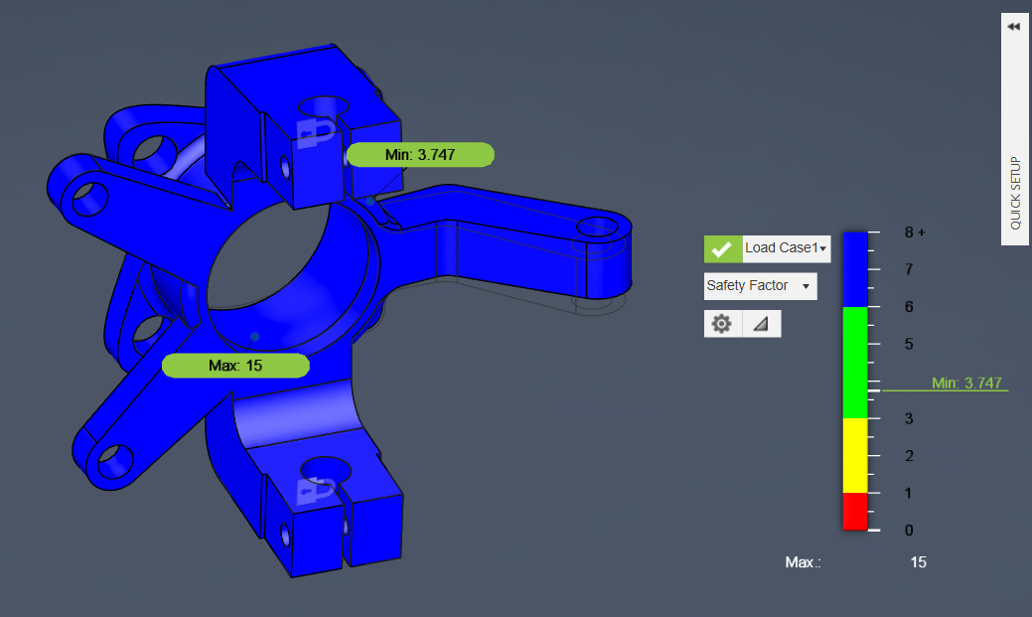
STEERING & WHEEL GEOMETRY
CENTRALIZED RACK AND PINION STEERING
WHEEL GEOMETRY
Camber Angle | -0.25°
Toe Angle | 0.35°
Castor Angle | 0.72°
Castor Offset | 4.64 mm
Kingpin Angle | 5.11°
Kingpin Offset | At Wheel - 25.12 mm At Ground - 13.63 mm
Wheelbase | 1550 mm
Track Width | Front-1500mm Rear - 1488mm
MIn. Turning Radius | 4284.33
Ackermann Percentage | 70.06 %
Steering Angles | Inner - 23.68° Outer - 17.11°
Rack Length | 14 inches
Rack Travel | 231.96 mm
Steering Ratio | 11.4 : 1
Steering Effort | 74 N
Torque on Pinion | 11250 N-mm
Steering Condition | Understeer
STEERING SPECIFICATIONS
Steering Column Type | Collapsible
Tie Rod Length | 473.14 mm
Lock to Lock Angle | 540°
Tie Rod Material | AISI 4340
Upright and Wheel HUb Material | Al 6061 T6
Steering Wheel Diameter | 12 inches
WHEEL HUB
STEERING KNUCKLE

Slide 7
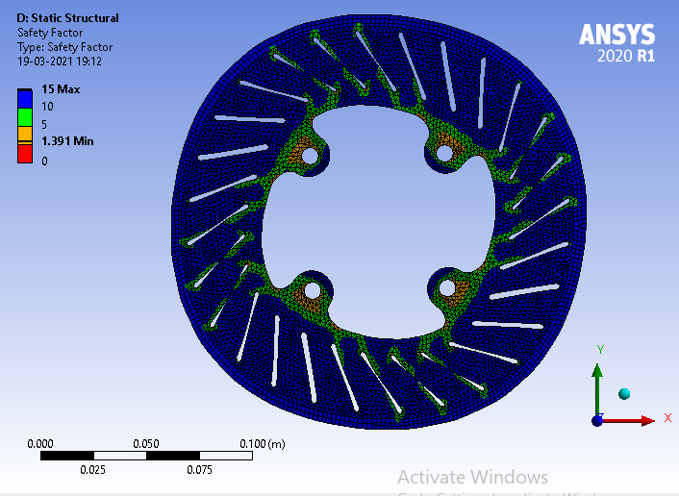
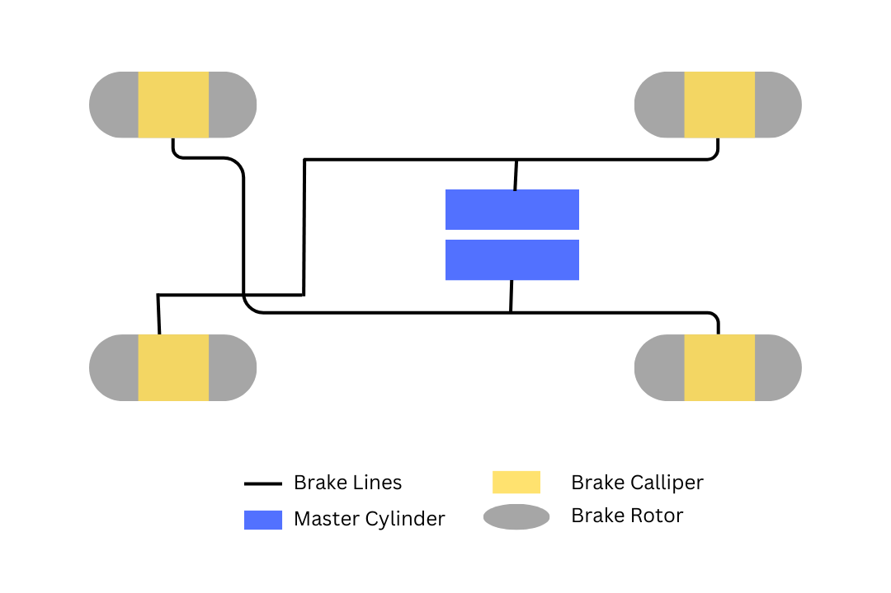
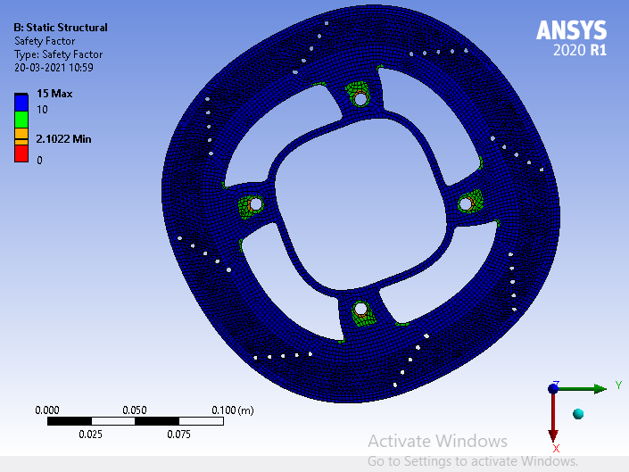
SPECIFICATIONS | VALUES
Pedal Force​ | 400 N
Pedal Ratio​ | 6:1​
Pedal Travel​ | 167.64 mm​
Brake Pad Area​ | ​706.858 mm²
Mean Braking Radius​ (front/rear) | 0.105m​ / 0.095m
Coefficient of Friction of ​Brake Pad​ | 0.4 ​
Deceleration ​ | 9.909 m/​s²
Braking Force​ | ​4954.586 N
Static Rolling Radius​ | 0.2921 m​
Static Axle Load(front/rear)​ | 981 N/ 1471.5 N​
Dynamic Axle Load(front/rear)​ | 1863.9 N/588.6 N
Weight Transfer (40 km/hr to 0 km/hr)​ | ​ 99.09 kg (990.9 N)
Brake Torque Applied​ (Front/Rear)​ | 497.576 Nm/ 452.342 Nm
Brake Torque Required​ (Front/Rear)​ | ​326.667 Nm /103.158 Nm
Coefficient of Friction of Road​ | 0.6
Stopping Distance​ (40 km/hr to 0 km/hr)​ | 6.228 m ​
Stopping Time ​ (40 km/hr to 0 km/hr)​ | ​1.212 s
BRAKING SYSTEM​
1.​ Inboards in Rear , Outboards in Front.
2.​ Front - Rear Applied Braking Force Split (70:30)
3.​ All wheels of the ATV lock together.
BRAKING SYSTEM
Braking Circuit
PARTICULARS OF BRAKING SYSTEM AND TYRES​
Parts​ | Quantity​ | Specifications​
Master Cylinder​ | 2​ | 0.75” dia.​ & Stroke length – 1.1”
Brake Caliper​ | 4 ​ | 30 mm dia.​
Brake Disc​ | 4 ​ | 220 mm (F)​/ 200 mm(R) dia.
Brake Fluid​ | -​ | DOT4​
Tyres​ | 4​ | BKT 23x10x10​

Slide 8
MOTOR SPECIFICATION
Motor Type | Permanent Magnet Synchronous Motor 48V
Rated Current(A) | 95
Rated Speed (RPM) | 2500±200
Rated Torque(Nm) | 18.23@2420
Output Max Torque(Nm) | 62.65@486
Continuous Rated Power(Kw)@RPM | 4096@2503
Max. Power(Kw)@RPM | 4619@2420
Efficiency(η) | >88%
Number of Poles | 8
 | Gear Ratio | Power on Wheels(W) | Torque to wheels(N-m) | Force on wheels(N) | Speed(kmph)
Continuous 18.23(Nm)@2420rpm | 6 | 1.11E+04 | 43.752 | 149.7331 | 44.415
 | 7 | 1.29E+04 | 51.044 | 174.6886 | 38.07
 | 8 | 1.48E+04 | 58.336 | 199.6441 | 33.31
Max 62.65(Nm)@486rpm | 6 | 7.65E+03 | 150.36 | 514.5791 | 8.9
 | 7 | 8.93E+03 | 175.41 | 600.3422 | 7.64
 | 8 | 1.02E+04 | 200.48 | 686.1054 | 6.68
POWERTRAIN
Gear material : AISI 4340
Tensile Strength: 745 Mpa
Yield Strength: 470 MPa
Bulk Modulus: 140 GPa
Shear Modulus: 80 GPa
Hardness, Brinell: 217
Thermal Property
Thermal expansion coefficient: 12.3μm/m°C
Thermal Conductivity: 44.5 W/mK
FNR SPECIFICATIONS
Specification: 1 module, 20 teeth, bevel gear with 2 x M4 screw holes, 8mm shaft, 1 input shaft drive 2 forward and reverse output shafts (2 output shafts rotating in opposite directions).
1:1 Right Angle Bevel Gearbox for Simple DIY Mechanical Application.

Slide 9
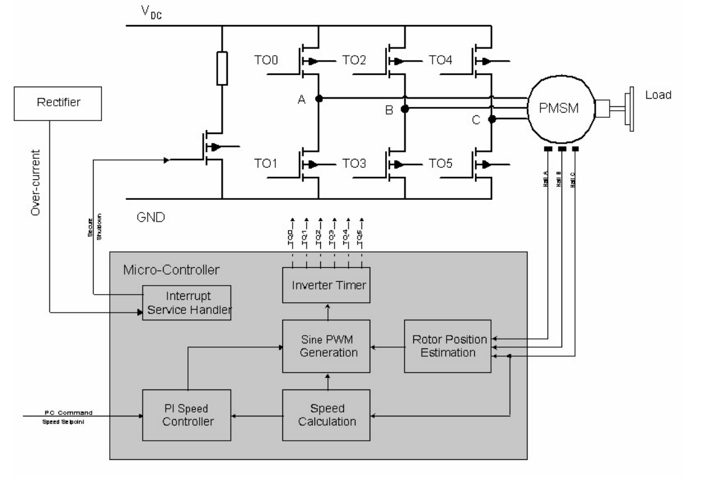
MOTOR CONTROLLER SPECIFICATIONS
MOTOR CONTROLLER CONNECTION CIRCUIT DIAGRAM
Rated Voltage | 48V
Peak Protection DC Current | 250A
Rated DC Current | 250A
Rated Power | 7500W
Under Voltage Protection | 42V
Natural cooling Ambient Temperature | 20-60 degree C
Throttle Voltage | 1V to 4.5V
Ambient Temperature | 20-60°C
TRACTIVE SYSTEM & CIRCUIT DESIGN
Cell Specification:
26650 5000mAh Cylindrical Li-ion rechargeable cell
Normal voltage: 3.6V
Charging voltage 4.2 ±0.05 V
Discharge ending voltage: 2.75±0.05 V
Standard charging current: 0.5C(2500mA)
Standard discharge current 0.5C(2500mA)
Max recommended charge and discharge cell body temperature:
Charge:0~60°C, Discharge:-20~60°C
Weight: 93±3g
BATTERY PACK SPECIFICATIONS
Battery Pack:
50V Capacity- 70Ah
Cell Arrangement: 14 Series, 14 Parallel
Total Weight: 20 kg (Approx)

Slide 10
Components | Specification
Ignition Switch or Master Switch | · Operating Voltage: 12 V · Connector Type: Plug In · Actuator Type: Rotatory · Weight: 480 g
Kill Switch: | Current Rating: 200 A Power/Voltage: 12 V
Brake Light | Brightness: 100 lm Color: Red Color Temperature: 41 K Operating Wattage: 55 W Operating Voltage: 12 V
TRACTIVE-SYSTEM-ACTIVE LIGHT (TSAL) | Light Colour: Amber Voltage: 12 V Light Source Type: LED Power:12W IP Rating:IP65 Frequency: 2 Hz
Components | Specification
READY-TO-DRIVE-SOUND (RTDS) | Rated Voltage: 12 VDC Sound Pressure Level: 85 to 95 decibels Max. Current: 10 mA Weight: 3 g
LV Harness | Harness is made from ISI approved cables of 1 mm². Length of LV harness will be supplied: - 3.5 mtrs
HV Harness | HV Harness is made from ISI approved cables of 16 mm² . Length of HV Harness supplied: - 1.5 mtrs
GLV SYSTEM & COMPONENTS
Reverse Alarm | Noise Level: 110 dB Voltage: 12 V Weight: 249 g

Slide 11

Designing & Simulation
Roll Cage
Integration of Design
Suspension
Redesigning
Transmission
Design Research
Steering
Simulation
Team Formation
Braking
Virtuals
May
June
July
August
September
October
November
PROJECT PLAN
March
February
January
December
Roll Cage
Suspension
Raw Material Procurement
Main Event
Transmission
Testing
Steering
Assembling
Braking
Manufacturing

Slide 12
ASSEMBLY | FAILURE MODE | CAUSES OF FAILURE | EFFECTS OF FAILURE | S | O | D | RPN | CURRENT DESIGN CONTROL
Frame | Structure Displacement | Axial stress exceeds yield stress of material due to excess load and impact loading | Frame structure will become prone to failure. |  |  | 5 | 36 | {P}-Choose material with appropriate/high factor of safety(FOS),effective design and analysis. {D}-Constant testing of the frame under different loads.
 | Bending of frame |  | Driver safety is at risk |  |  | 7 | 126
 | Breaking of Frame |  |  |  |  | 10 | 200
Battery Pack | high-current cycling regime | SEI deterioration and non-uniformity on the anode pitting corrosion on the cathode Al current collector. | Battery failure |  |  | 1 | 80 | {P}-current limiters, avoid overcharging {D}-temperature monitoring
 | storage at elevated temperatures |  | Battery failure |  |  | 1
Transmission System | Motor Overheating | Continuous high loads or insufficient cooling | Reduced power output, damage to motor components, and risk of system failure |  |  | 7 | 24 | {P}-Incorporating thermal management strategies. {D}Use temperature sensors to continuously monitor motor’s temperature.
 | Gear Damage | Excessive torque, poor lubrication, or manufacturing defects in gears. | Gear noise, power loss, total failure of transmission system. |  |  | 1 | 17 | {P}-Use high quality gears and proper lubrication. {D}-Use vibration sensors to detect unusual vibrations due to damage to gears.
 | Controller Malfunction | Software bugs, electrical issues, or sensor failures. | Inability to control the power delivery to motor efficiently, leading to erratic performance. |  |  | 1 | 21 | {P}-Redundant sensors for critical parameters. {D}-Diagnostic capabilities in the controller to identify issues.
Steering System | Breakage of steering wheel. | Excess load applied by driver. | Inability to control the vehicle. |  |  | 8 | 64 | {P}-Buying of steering wheel from a reputed manufacturer . Regular testing for the proper working of steering wheel.
Braking System | Mechanical failure | Improper fitting of the components. | Damage to vehicle in undesirable conditions |  |  | 1 | 9 | {P}-Proper torquing for the fitment using torque wrench {D}-Use of torque meter to ensure proper torquing .
 | Leakage of brake fluid | Wrong selection of material ,joint dimension ,mismatch in rake pipe and master cylinder. | Braking system failure |  |  | 2 | 40 | {P}-Simulation for burst pressure ,stress and strain design calculation for flared thread dimension . {D}-Material test dimension measurement + burst pressure measurement +100% part leak test for 200 bar for 30 sec.
 | Structure failure of brake pedals due to fatigue | Excess application of load by driver causes axial load to exceed yield strength of material. | Brake failure risking drive's safety |  |  | 1 | 10 | {P}-Choose material with high FOS and buying the pedal from reputed manufacturer. {D}-Regular testing of proper working of pedals.
Suspension | Mechanical failure of control arms | Axial stress exceeds yielding stress of material due to excess load and impact loading | Damage to suspension. System and rough Operation or non-operation of the vehicle. |  |  | 7 | 112 | {P}-Choose material with high FOS and according to vehicle specification; effective design and analysis. {D}-Regular testing of the control arms under different conditions.
 | Breakage due to structural failure of Knuckle | Failure due to bending ,crushing and tensile stress and double shear. | Damage to suspension system and rough operation or non-operation of the vehicle |  |  | 2 | 32 | {P}-choose material with high FOS and according to vehicle specifications. {D}-Regular testing of the Knuckles.
Wheels | Breaking of the rims | Damage by debris pollution. | Vehicle inoperable. |  |  | 1 | 8 | {P}-Buying of wheel rims from a reputed manufacturer regular testing of wheel rims.
S=SEVERITY 8 9 10 O=OCCURRENCE 1 2 D=DETECTION RANKING RPN=RISK PRIORITY NUMBER {P}Prevention {D}Detection
DFMEA & PFMEA

Slide 13
COMPONENT | DESIGN VALIDATION & TESTING
Frame | Structural Simulation while designing the chassis
 | Dynamic Crash Simulation in Radioss
 | Welding the rods in CAD for manufacture ability
Ergonomics | Rapid Upper Limb Assessment / Rapid Entire Body Assessment
CVT | Modeling CVT of BAJA ATV using MATLAB,Simulink & Simscape
Brake Disk | Thermal Stress for brakes for testing brake failure
Suspension | Dynamic Analysis of bump and roll in Lotus Software
A-Arm & H-Arm | Structural/ Dynamic Analysis for A-Arm and H-Arm
Upright/Wheel Hub | Structural Simulation for upright and Wheel Hub
 | Creating C.N.C tool paths for manufacturing ability
Steering | Simulating Steering System using software packages
Design Validation Plan

Slide 14

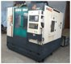
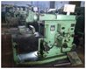
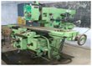
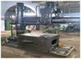
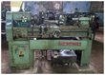
COLLEGE FACILITIES |  | OUTSIDE FACILITIES
CAD/CAM LAB​ | Drilling Machine ​ | FRP Fabrication​
TIG Welding Machine ​ | Cutting Tools ​ | FRP Moulding​
Universal Testing ​ Machine ​ | Bench and Hand Grinder​ | Hydraulic Press Fit​
Electric Arc Welding Machine ​ | Vertical Milling Centre (VMC)​ | Emission Test Equipment​
Production lathe​ | Shaping Machine​ | Tyre Balancing​
Body paint Shop ​ | 3D Printer​ | Panel Fabrication​
COLLEGE FACILITIES |  | OUTSIDE FACILITIES
CAD/CAM LAB​ | Drilling Machine ​ | FRP Fabrication​
TIG Welding Machine ​ | Cutting Tools ​ | FRP Moulding​
Universal Testing ​ Machine ​ | Bench and Hand Grinder​ | Hydraulic Press Fit​
Electric Arc Welding Machine ​ | Vertical Milling Centre (VMC)​ | Emission Test Equipment​
Production lathe​ | Shaping Machine​ | Tyre Balancing​
Body paint Shop ​ | 3D Printer​ | Panel Fabrication​
Karthikeyan Gali(H)
Shubham Jaiswal
Kishore Pal
Vaishnavi Devgire
Sai Saketh
Arunava Pal (H)
Ishita Chaudhary (VC)
Tuhin Mondal
Modasshir Jamal
Ritesh Gupta
Tharun Nataraj Dhandapani
Deeksha Yadav
Transmission
Suspension
Transmission
Suspension
Faculty Advisor
Dr. Aritra Ganguly
TEAM & Workshop Facilities
Braking
Braking
Steering
Steering
Sabavath Akash(H)
Koushik Ghosh
Subhankar Mondal
Ivan Jacob Thomas
Krishnendu saha
Roll Cage
Roll Cage
Ankush Ghosh (H)
Soham Banerjee
Piyal Bhowmick
Shivang Agrahari
Sanatan Samantara
VMC
Milling Machine
Lathe Machine
Sayan Mondal (H)
Ketan Masurkar(C)
Piyush Pathak
Shivani Saha
Vaibhav Sarkar
Sreyankur De
Diya Hansda
Arunabh Bagchi
INDEX
 | Documentation​
 | Market Analysis ​
​ | Calculations​
Drilling Machine
Shaping Machine

